Slide 1
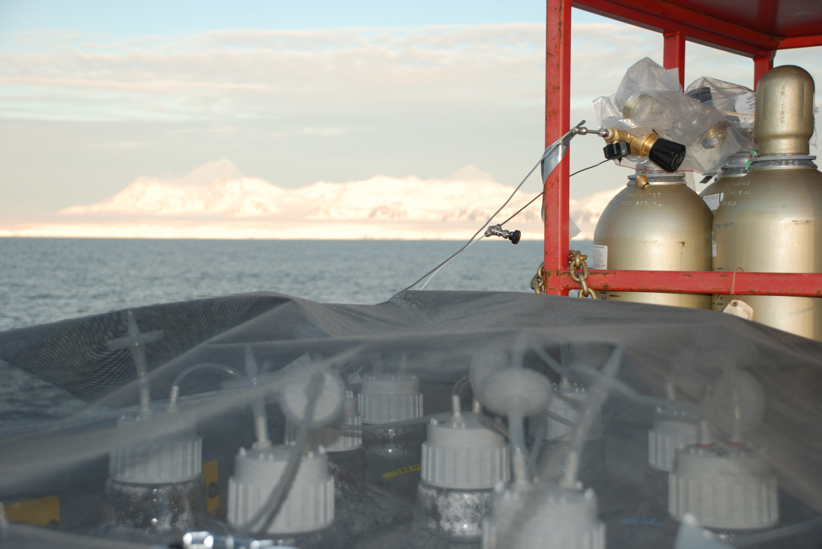
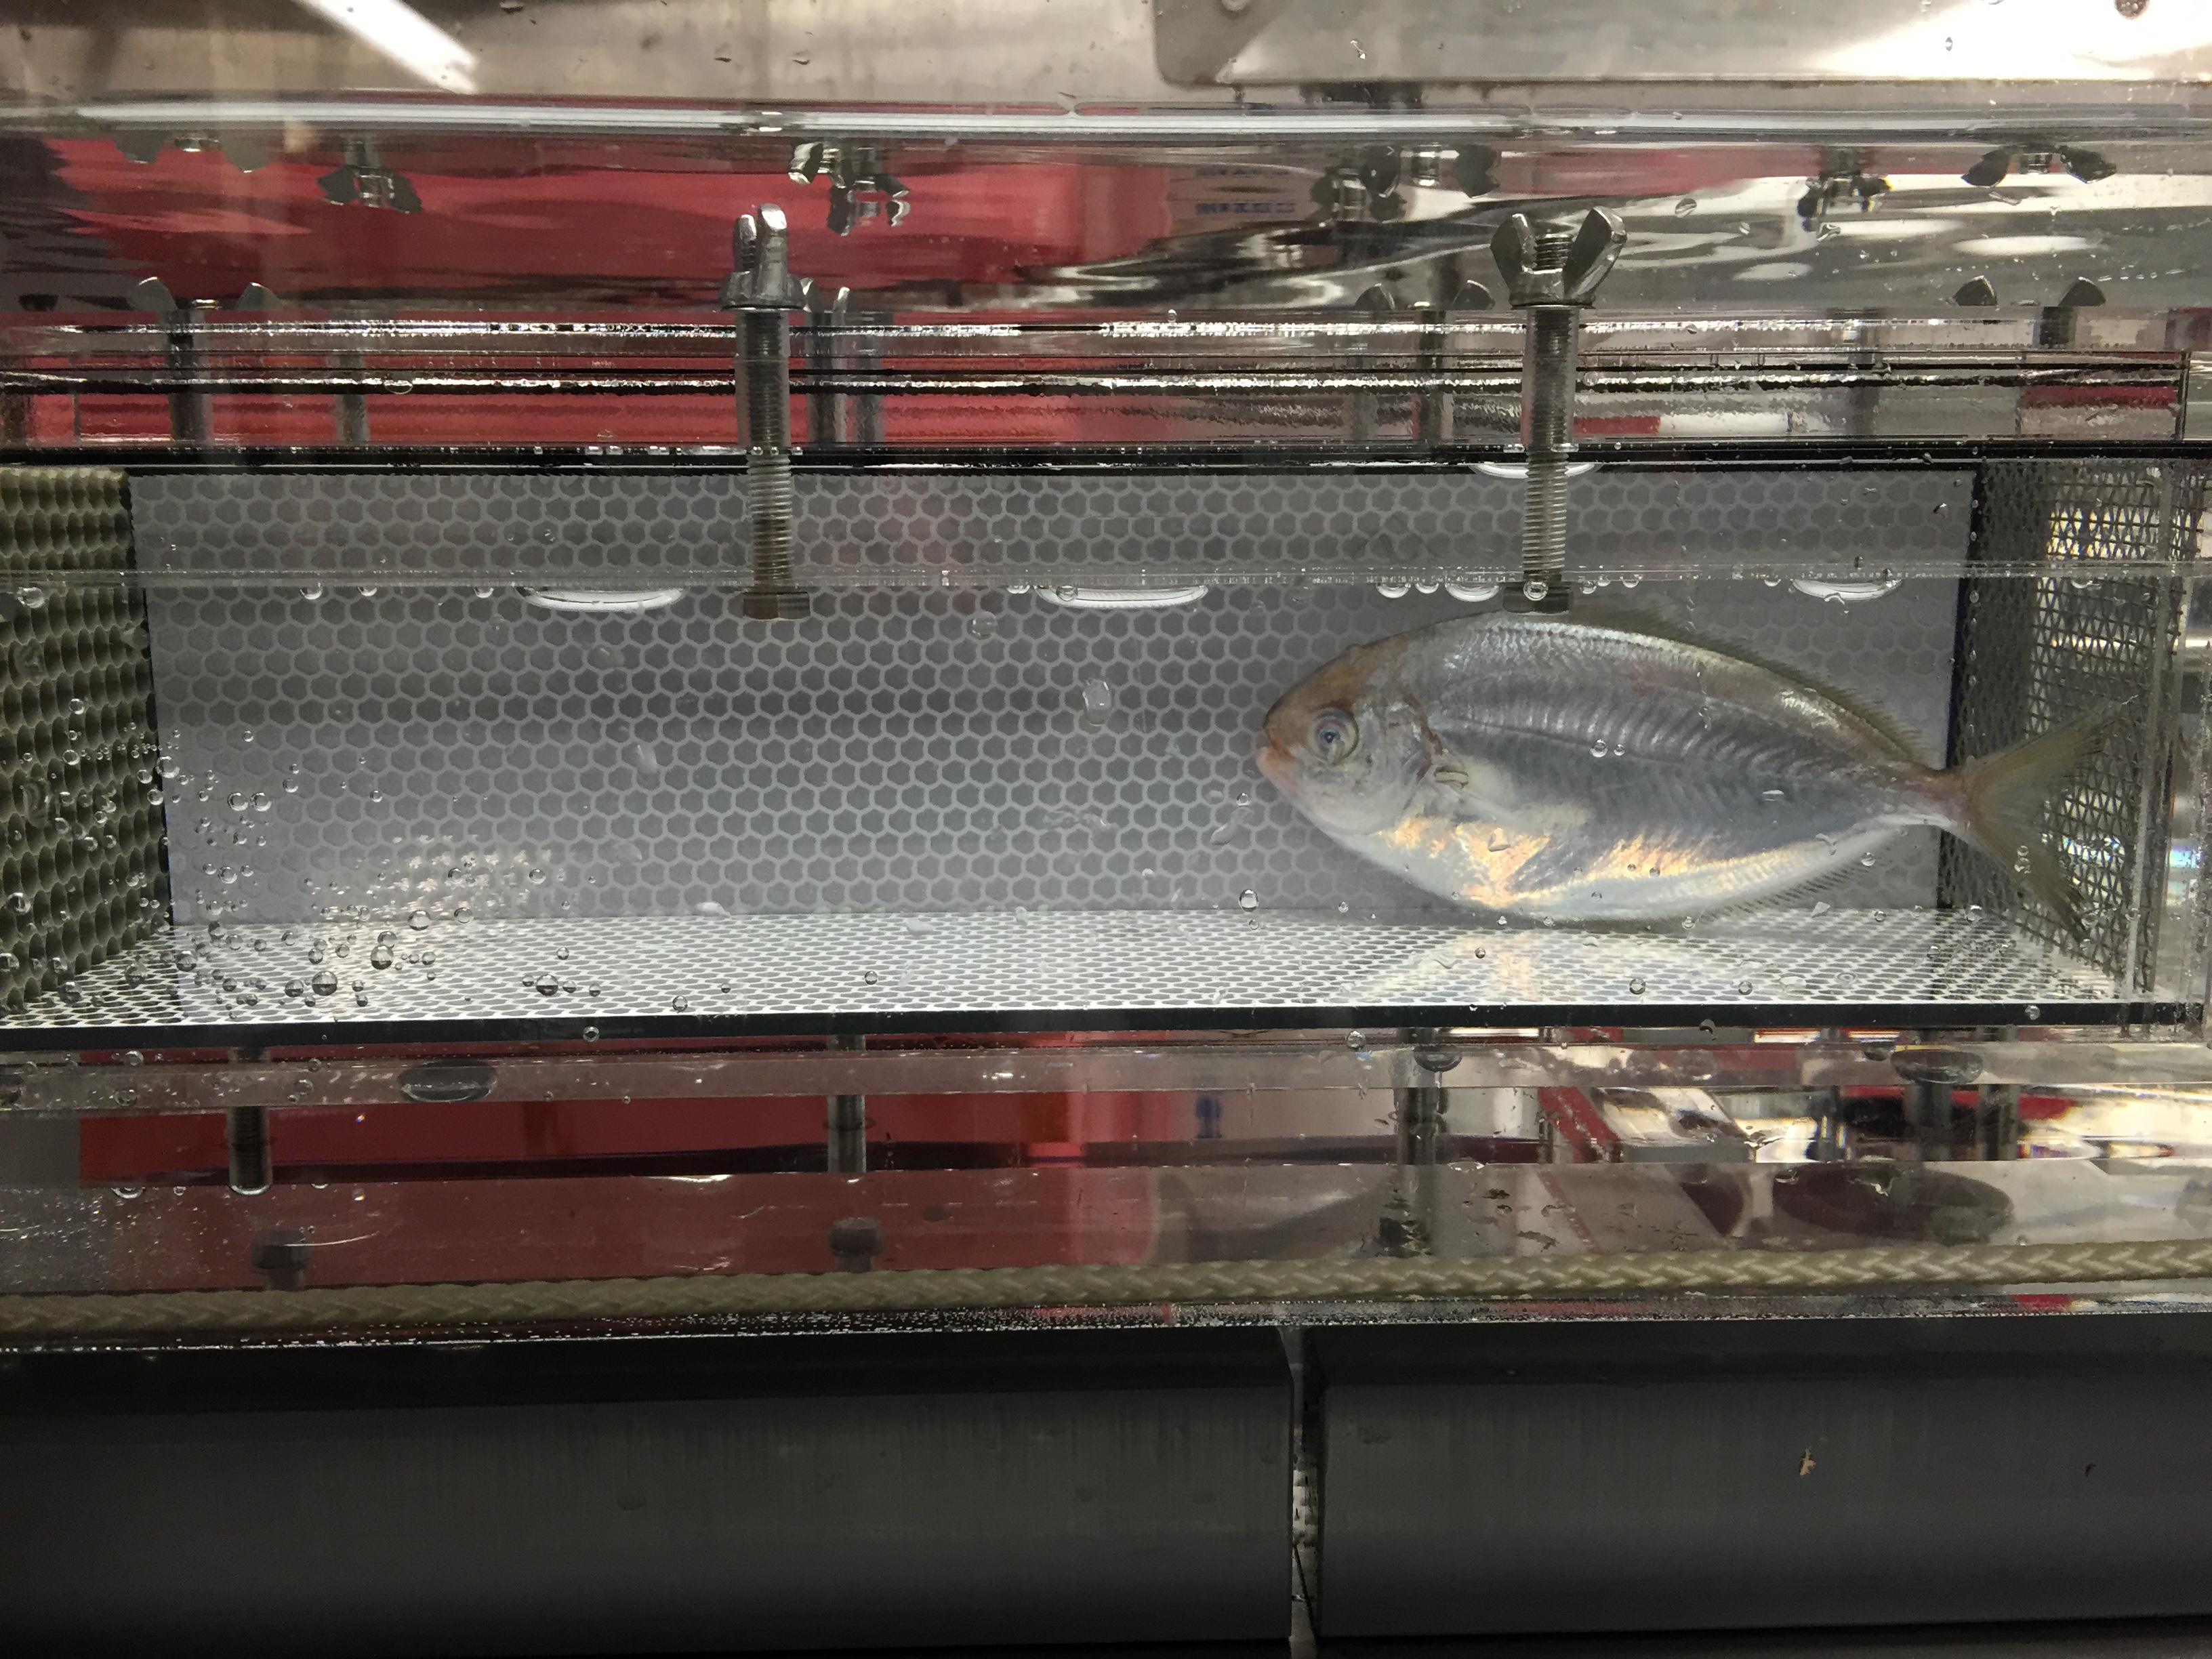
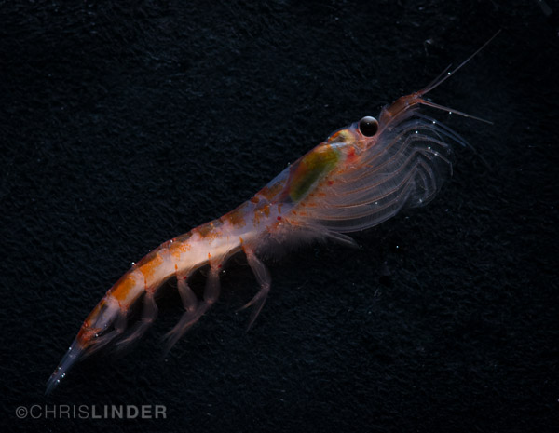
Ocean Acidification
Courtesy of: Grace Saba Assistant Professor Center for Ocean Observing Leadership Department of Marine & Coastal Sciences saba@marine.rutgers.edu

Slide 2
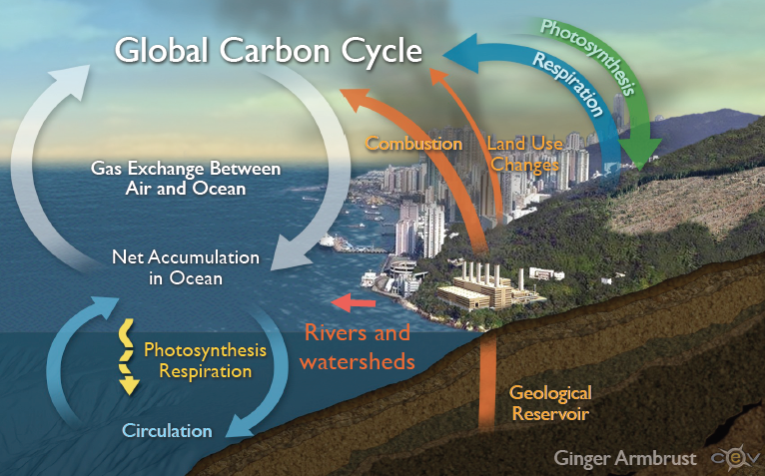
Humans are Impacting the Ocean
Notes:
Since the end of the first Industrial Revolution in the 1830s, widespread burning of fossil fuels, deforestation, and cement production have released more than 440 billion metric tons of CO2 into the atmosphere (half of that in the last 30 years). This mass release of previously “locked away” carbon enhances the natural greenhouse effect, trapping more and more heat in our atmosphere. That’s one problem with CO2.
Notes: Cement manufacturing releases CO₂ in the atmosphere both directly when calcium carbonate is heated, producing lime and carbon dioxide, and also indirectly through the use of energy of its production involves the emission of CO₂

Slide 3
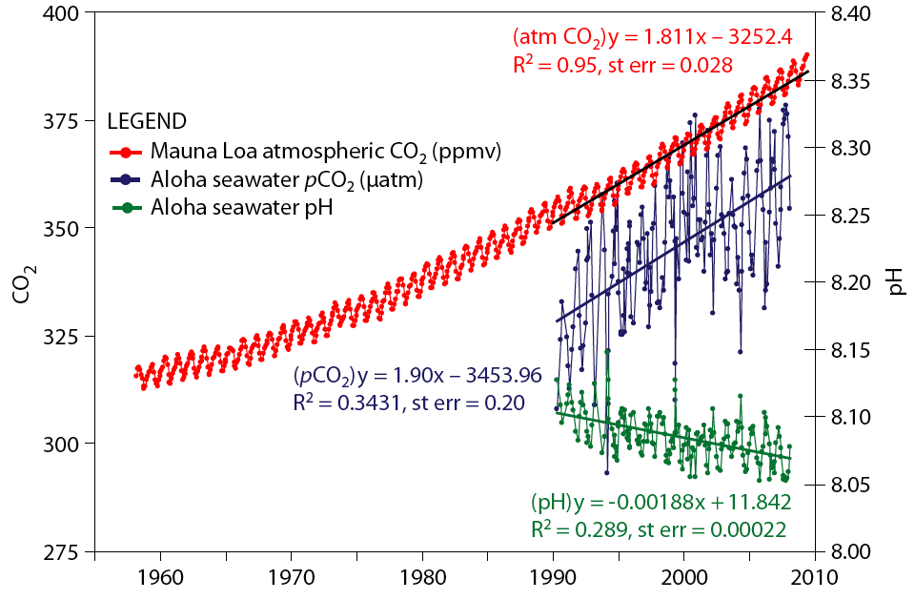
The Other CO₂ Problem
Atmospheric CO₂ has increased 40% since the 1800s
Drop of 0.1 pH unit
28% increase in ocean acidity
CO₂ is projected to double by 2100 (IPCC)
Additional drop of 0.2-0.3 pH units
Equivalent to 100-150% increase in ocean acidity
Rate of change 10x faster than at any time in the past 65 million years
Notes:
The Intergovernmental Panel on Climate Change (IPCC) predicts a doubling of current CO2 concentrations by the end of the 21st century, which is equivalent to an additional drop of 0.2 to 0.3 pH units and a 100-150% increase in ocean acidity since before the industrial revolution.
Today’s rate of acidification is 10 times faster than anything experienced since the demise of the dinosaurs 65 million years ago.
EXTRA:
This will cause an increase in the heat content of the upper 700 m of the global ocean, which will lower absorption of CO2 into the ocean and decrease the ocean’s ability to act as a CO2 sink
Seawater is a natural buffering system for the carbonate system. However, INCREASE IN CO2 ALSO DECREASES OCEAN’S BUFFERING CAPACITY!

Slide 4
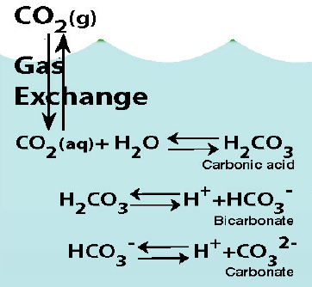
The chemistry of OA: carbonate chemistry
Increase in seawater CO₂:
Increase in seawater carbonic acid, H₂CO₃
Release of hydrogen, H⁺, ions into the seawater
Decrease pH = increase ocean acidity
Notes:
This carbonic acid then dissociates into bicarbonate and carbonate and releases hydrogen ions. These chemical reactions (release of hydrogen ions) cause a reduction in seawater pH, which is a measure of increased acidity.

Slide 5
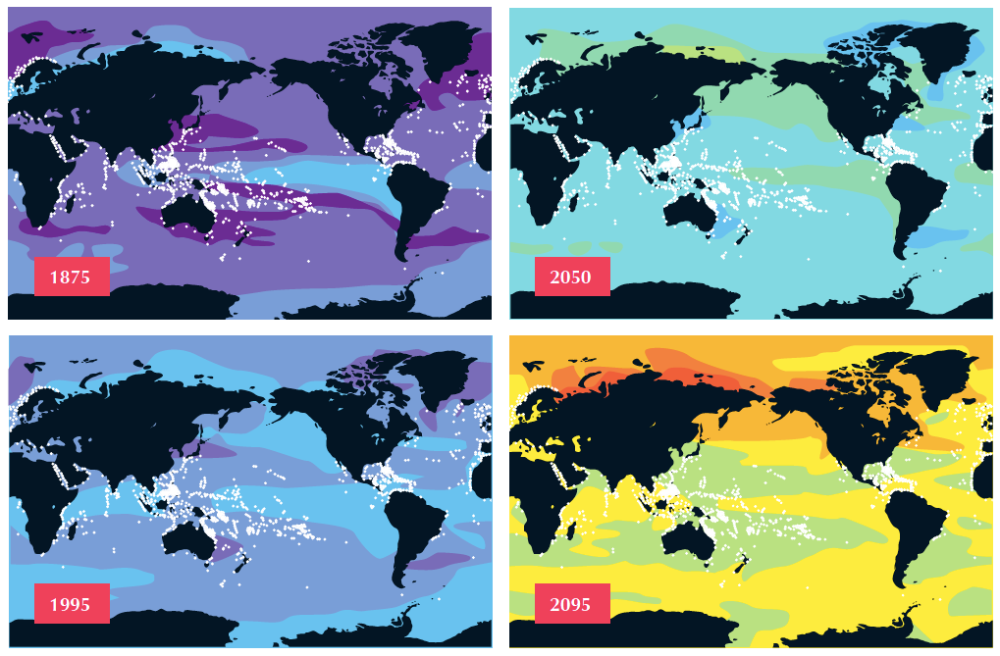
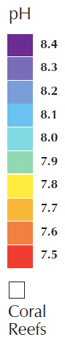
Climate Model Projections: pH
Notes:
National Center for Atmospheric Research Community Climate System Model 3.1 (CCSM3) modelled decadal mean pH at the sea surface for 1875, 1995, 2050 and 2095. Source after Feely et al., Oceanography (2009).

Slide 6
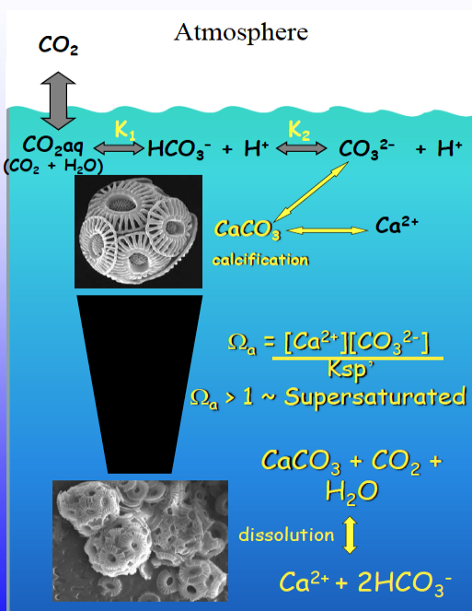
Calcification and the Saturation State
Ω = potential for the mineral to form or dissolve
product of concentrations of reacting ions that form the mineral
Product of the concentrations of those ions when mineral is at equilibrium (Ksp)
Ω =
Ωa > 1: supersaturation of carbonate ions = precipitation
Ωa < 1: undersaturated = dissolution
Notes:
Calcification involves the precipitation of dissolved ions (Calcium and carbonate) into solid CaCO₃ structures, for instance these individual plates called coccoliths on this single celled phytoplankton called a coccolithophore. After they are formed, such structures are vulnerable to dissolution unless the surrounding seawater contains saturating concentrations of carbonate ions.
The saturation state of seawater for a mineral (known as omega, Ω) is a measure of the thermodynamic potential for the mineral to form or to dissolve, and is described by this equation. Here omega (Ω) is the product of the of the reacting ions that form the mineral (Ca2+ and CO2−3), divided by the product of the concentrations of those ions when the mineral is at equilibrium (K_{sp}), that is, when the mineral is neither forming nor dissolving. In seawater, an omega (Ω) with a value greater than 1, allows for the precipitation of CaCO₃. Most calcifying organisms live in such waters. In seawater with an Ω value less than 1, carbonate ions are undersaturated and CaCO₃ will dissolve.
Therefore, the saturation state is the key component of the seawater carbonate system that controls calcification rates.

Slide 7
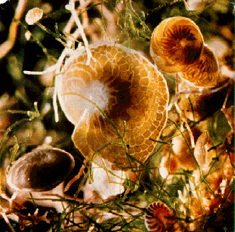
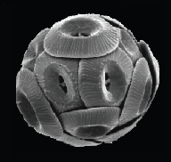
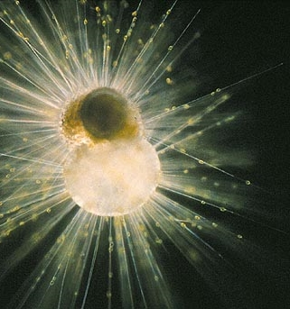
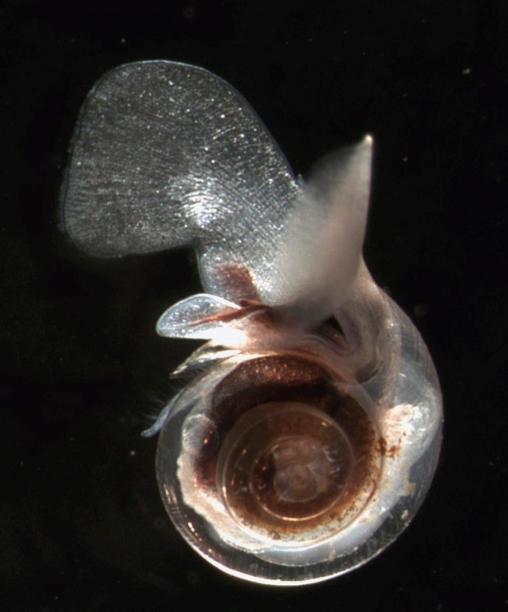
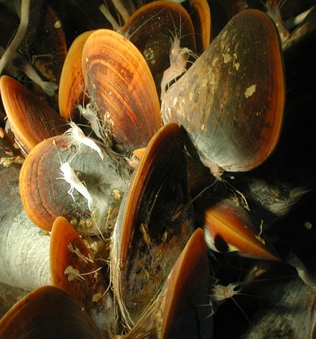
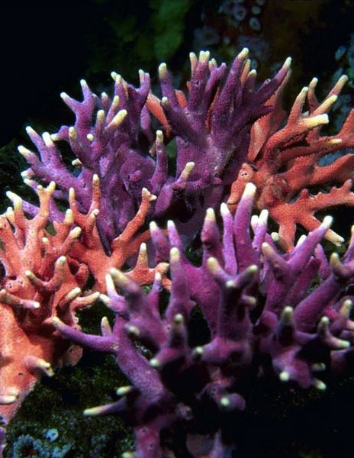
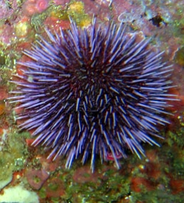
What potential impacts could ocean acidification have on marine organisms and why?
Notes:
The carbonate ion is an essential ingredient in the creation of calcium carbonate shells and skeletons produced by a large number of marine organisms (e.g., corals, marine plankton, coralline algae, and shellfish).
Thus, calcification is therefore harder to achieve, and may be prevented altogether in a more acidic ocean. This impact of ocean acidification may therefore have potentially catastrophic consequences for ocean life and many species of economic importance.

Slide 8
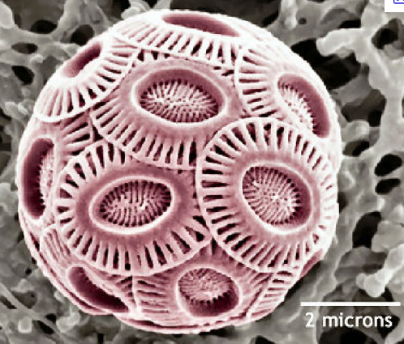
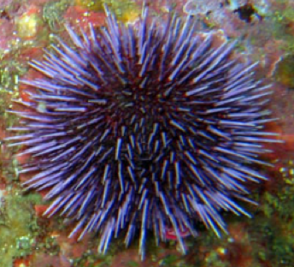
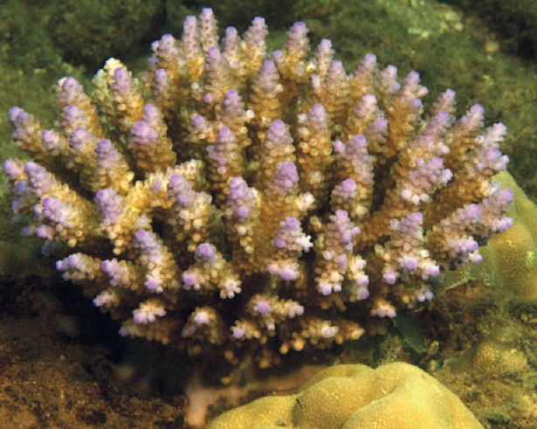
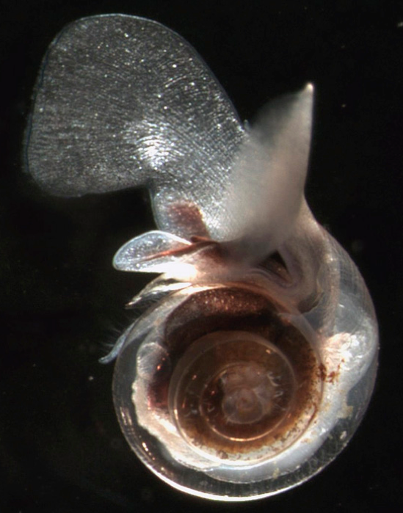
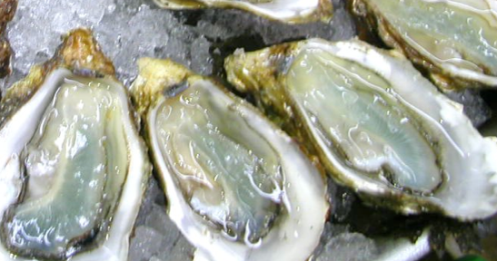
Calcification and the Saturation State
Calcite
Aragonite
More soluble
More vulnerable
Notes:
Calcium carbonate occurs in 2 common polymorphs: aragonite and calcite. Aragonite is much more soluble than calcite. This means that those organisms that produce aragonite (most corals, most molluscs including free-floating zooplankton snails called pteropods) may possibly be more vulnerable to changes in ocean acidity than those that produce calcite (coccolithophores, echinoderms/urchins, oysters).
SUMMARY: As described above, under normal conditions, calcite and aragonite are stable in surface waters since the carbonate ion is at supersaturating concentrations. However, as ocean pH falls, so does the concentration of this ion, and when carbonate becomes undersaturated, structures made of calcium carbonate are vulnerable to dissolution. Even if there is no change in the rate of calcification, therefore, the rate of dissolution of calcareous material increases.

Slide 9
Oysters in Pacific Northwest
Taylor Shellfish Farms;
Dabob Bay Hatchery
Goose Point Oyster Co.
Whiskey Creek Hatchery
80% decrease in oyster production in 2008/2009 linked to ocean acidification
Notes:
Taylor Shellfish—the West Coast’s largest producer of farmed shell- fish—saw its oyster production plummet by 80 percent a few summers ago. Thanks to the new equipment and favorable weather, the company has since hit record production levels.
Continued inadequate funding for ocean acidification monitoring puts shellfish producers—as well as commercial fishermen—in a risky position. Just as mariners rely on accurate weather forecasts before heading out to sea, fishermen need to know which species and fishing grounds are vulnerable to rising acidity in the sea

Slide 10
Oysters in Pacific Northwest
(Bill Dewey, Taylor Shellfish Farms)
Notes:
Taylor Shellfish—the West Coast’s largest producer of farmed shell- fish—saw its oyster production plummet by 80 percent a few summers ago. Thanks to the new equipment and favorable weather, the company has since hit record production levels.
Continued inadequate funding for ocean acidification monitoring puts shellfish producers—as well as commercial fishermen—in a risky position. Just as mariners rely on accurate weather forecasts before heading out to sea, fishermen need to know which species and fishing grounds are vulnerable to rising acidity in the sea

Slide 11
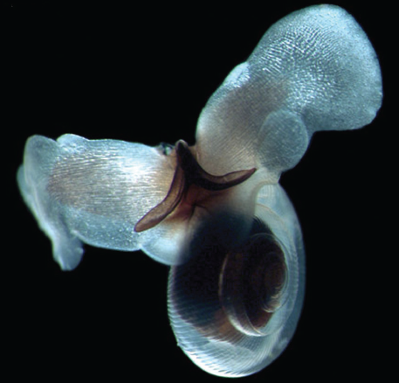
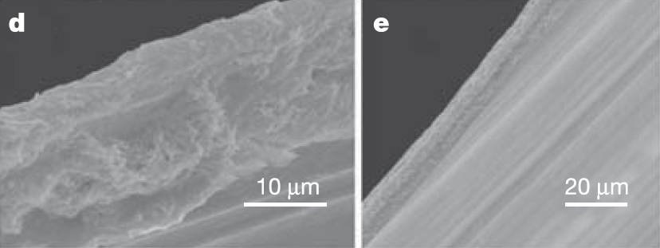
Marine snails, Pteropods
Shelled pteropods can reach densities of 10,000 individuals m⁻³ in high-latitude areas and ~25% of total zooplankton biomass in the Southern Ocean
Important prey species for a variety of other zooplankton and fish
Contain a soluble calcium carbonate shell (aragonite)
UNDERSATURATION
SUPERSATURATION
Dissolution of Clio pyramidata shell (Orr et al. 2005)
Notes:
There has been much recent focus on these organisms. In this study by Orr and colleagues, significant dissolution of the shell of the pteropod Clio pyramidata occurred within only 48 hours when exposed to undersaturated seawater. These results suggest that in only 18 years from now, we will likely see major changes in the presence of this organism in Antarctic waters.

Slide 12
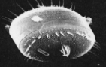
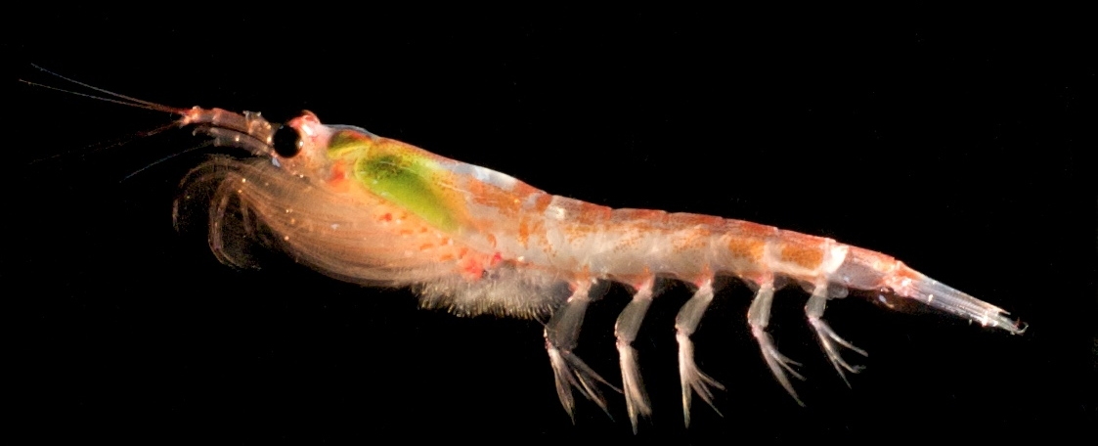
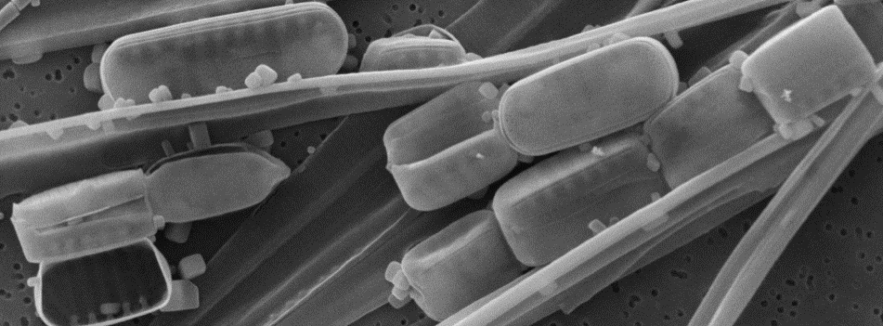
What potential impacts could ocean acidification have on NON-CALCIFYING marine organisms and why?
Notes:
Ocean acidification will not only affect calcifying organisms. NON-calcifying organisms (such as phytoplankton called diatoms, and krill shown in these photos) will also likely be affected through direct, indirect, and subtle responses to an acidifying ocean. Most of ocean acidification research so far has focused mainly on calcification rates of calcifying organisms, especially tropical corals and planktonic coccolithophores. We are just beginning to understand other physiological responses to ocean acidification and I will cover a few of these here.

Slide 13
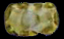
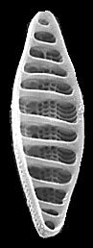
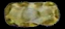
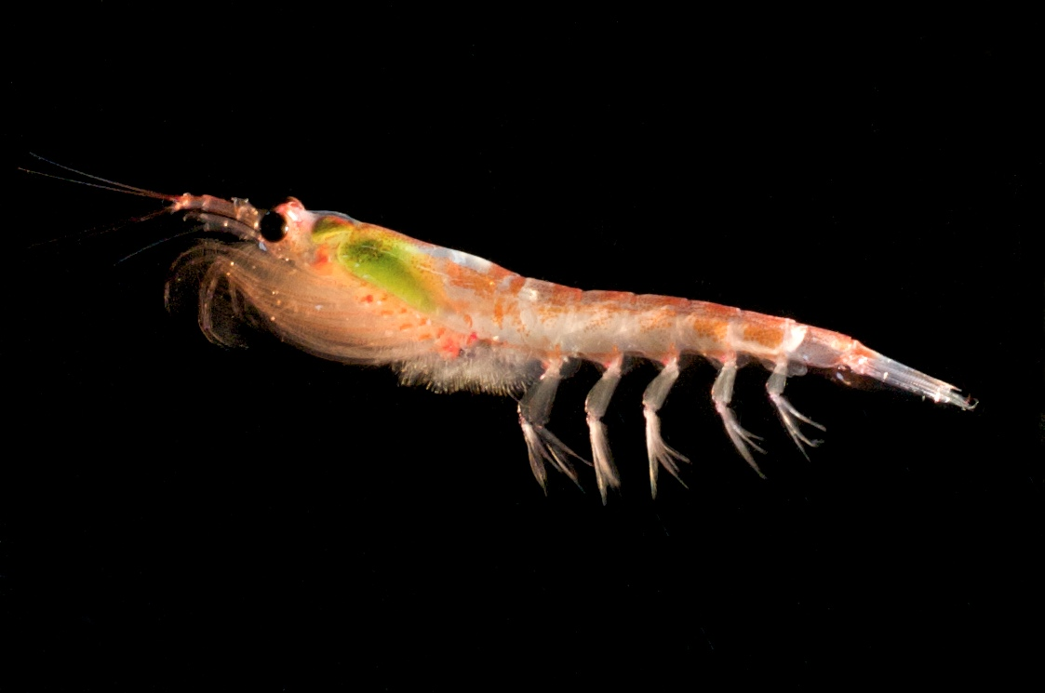
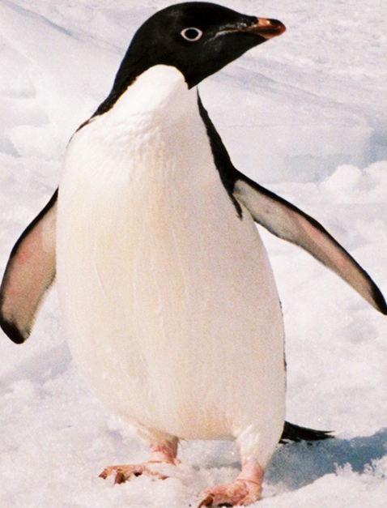
Effects on biogeochemistry and food webs
High CO₂
Large cells
Biomass
Productivity
N, P, Si, Fe uptake
Would diatoms ultimately become nutrient limited?
Notes:
This scenario shows diatoms experiencing positive growth and productivity under higher CO2/more acidic conditions. Large diatoms will favor transfer of C to higher trophic levels such as krill, penguins, and whales.
However, higher biomass and productivity of large diatoms will also increase nutrient utilization and may drive the system to nutrient-limitation over longer timescales, and this needs to be considered in future manipulations.

Slide 14
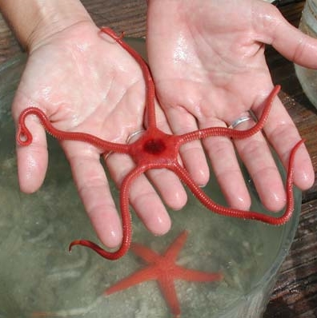
pH effects on brittle star metabolism & growth
Wood et al. 2008
8.0
7.7
7.3
6.8
8.0
7.7
7.3
6.8
pH
pH
pH = 8.0
pH = 6.8
MUSCLE
LOSS
Notes:
Increased growth and metabolism was also observed in brittle stars at reduced pH/elevated CO₂
but the cost - muscle wastage - was substantial.
Longitudinal cross sections of established brittle star arms mounted in methacrylate resin and stained with Lee’s basic blue fuchin.

Slide 15
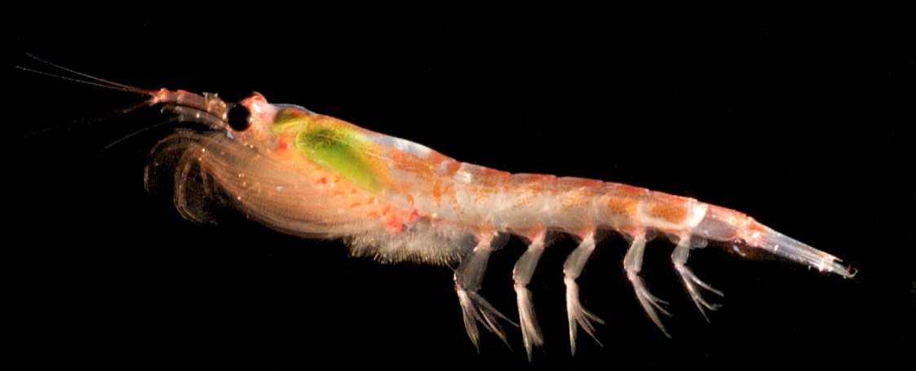
OA effects on krill metabolism & growth
FEEDING
EXCRETION
(Saba et al., 2012)
Euphausia superba responded to elevated CO₂ by:
Increasing ingestion rates
Increasing nutrient release rates and metabolic activity
Increased metabolism reflects enhanced energetic requirements of acid-base regulation
Associated compensation costs included the breakdown and loss of proteins
Notes:
Euphausia superba responded to elevated CO₂ by increasing ingestion rates, nutrient release rates, and metabolic activity, reflecting enhanced energetic requirements of acid-base regulation, but the associated compensation costs included the catabolism of proteins and differential partitioning of C and N, which created stoichiometric changes within the krill which could, in the long-term, decrease growth and reproduction and negatively impact an already declining krill population.

Slide 16
Olfactory impairment
Larval clownfish cannot distinguish their parental home under high CO₂
Can not distinguish between their parents and other adults (problems with inbreeding)
Coastal and reef fish rely on smell and taste to find their habitats
Munday et al. 2009
Notes:
We tested the effects that ocean acidification from elevated levels of atmospheric carbon dioxide (CO₂) could have on the ability of larvae to detect olfactory cues from adult habitats.
Larval clownfish reared in control seawater (pH 8.15) discriminated between a range of cues that could help them locate reef habitat and suitable settlement sites. This discriminatory ability was disrupted when larvae were reared in conditions simulating CO₂-induced ocean acidification.
Larvae became strongly attracted to olfactory stimuli they normally avoided when reared at levels of ocean pH that could occur ca. 2100 (pH 7.8) and they no longer responded to any olfactory cues when reared at pH levels (pH 7.6) that might be attained later next century on a business-as-usual carbon-dioxide emissions trajectory

Slide 17
Multi-stressors

Slide 18
What are we doing about it?
NOAA Science Centers: Coordinated research with academic partners
Expanding Monitoring Efforts
Individual efforts
Usually short-term, localized
Potential for being embedded into larger efforts or networks
Sensor development and integration into monitoring platforms
National/international efforts
NOAA National Coral Reef Monitoring
NOAA Integrated Ocean Observing System (IOOS)
NSF Ocean Observing Initiative (OOI)
Global Ocean Acidification Observing Network (GOA-ON)
Notes:
Increasing efforts to monitor and experimentally determine biological response

Slide 19
What are we doing about it?
Regional Coastal Acidification Networks (CANs): Bring together researchers, stakeholders, natural resource managers, and the general public to address coastal acidification issues
The most recent addition is our very own Mid-Atlantic Coastal Acidification Network (MACAN): www.MidACAN.org
Notes:
Building strategic plans to identify research priorities and a monitoring plan

Slide 20
MACAN Monitoring Map
Notes:
Additionally, we have made this map interactive, so that if you hover or click on a specific sampling site, a window will pop up and give you metadata showing...
At first glance of the static map, it looks as if the Mid-Atlantic is well sampled for acidification. But if you look deeper, obvious gaps in the monitoring appear.

Slide 21

Monitoring gaps to discuss
Sampling frequency can be too low to capture short­-term epi­sodic events
Often, only one carbonate system parameter is measured
Most sampling done at surface, but subsurface waters are typically more acidic
Notes:
Even in cases where high­-frequency observations are being recorded, often, only one acidification parameter such as pH is measured, which does not allow full characterization of acidification (including saturation states that can directly impact organisms that build calcified structures).
This limits the utility of the data.
…due to the biological process of remineralizing sinking particulate organic surface material.
A recent NOAA OAP-funded East Coast OA (ECOA I) cruise in summer 2015 was dedicated to acidification-focused carbonate chemistry measurements. This survey revealed the existence of low pH water in bottom Cold Pool waters in the MAB shelf.
Figure. Vertical sections of (top) pH and (bottom) temperature from a cross-shelf transect in New Jersey in the Middle Atlantic Bight (MAB).

Slide 22
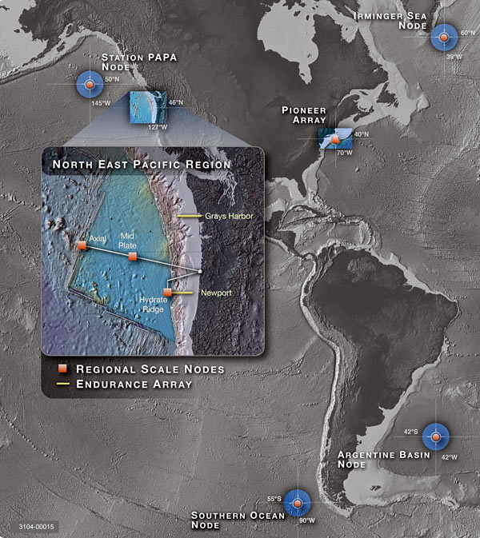
Long-Term Observatories (OOI)
Abundant power supplied by electro-optical cable and battery packs
Near real-time data and feedback
Shoreside monitoring and instant knowledge of any changes in functionality
Ability to change sampling program on the fly
New sensor developments
A consistent, long-term presence and observational/experimental platform

Slide 23
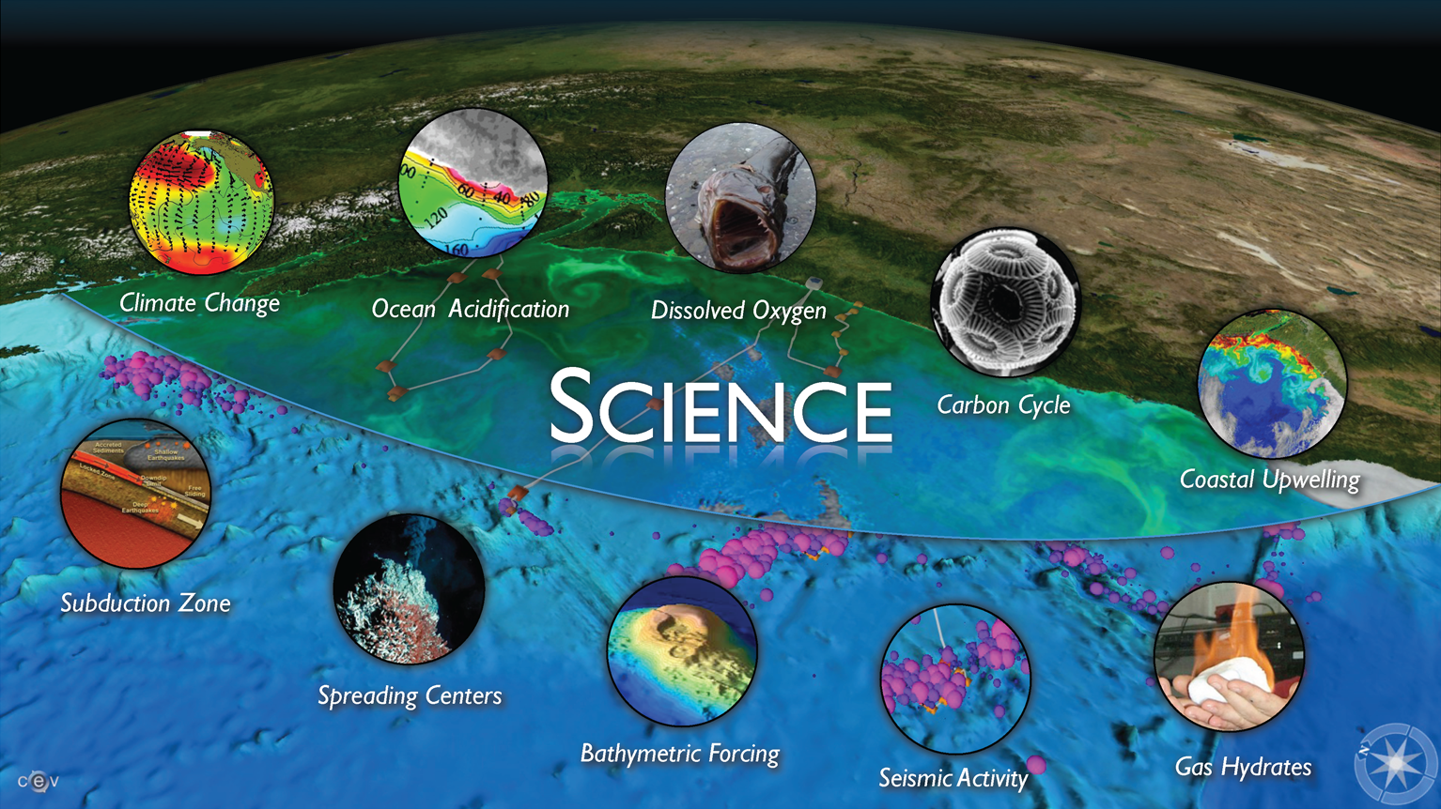
Notes:
I think this one says the same thing as one of our other slides, so it can be removed. … A brief discussion of the science themes that are driving the Endurance Array design. Endurance Array will address the top five. Also want to talk a little bit about data accessibility and how it will be publicly available with minimal delay.

Slide 24
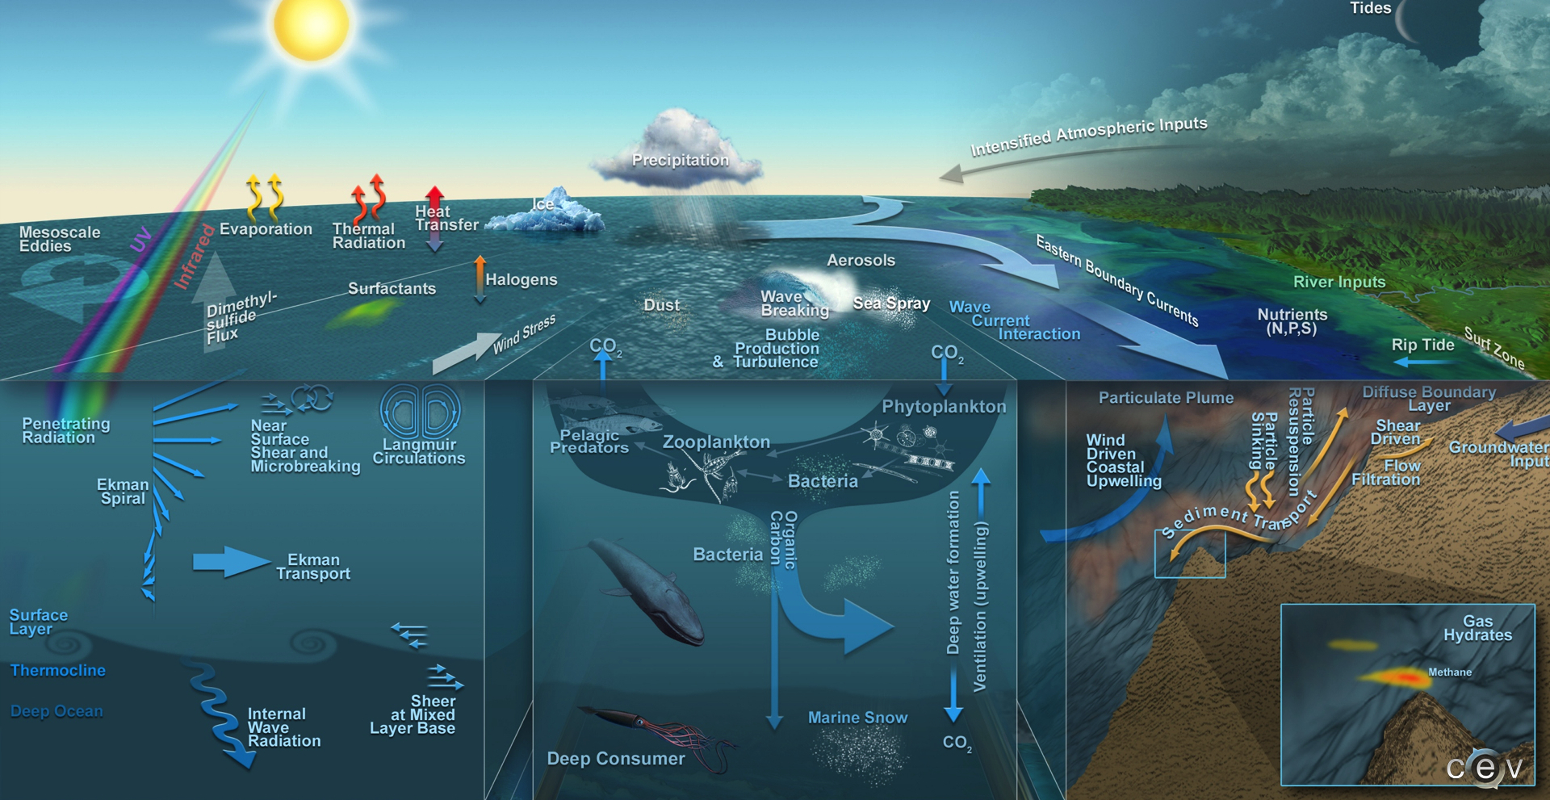
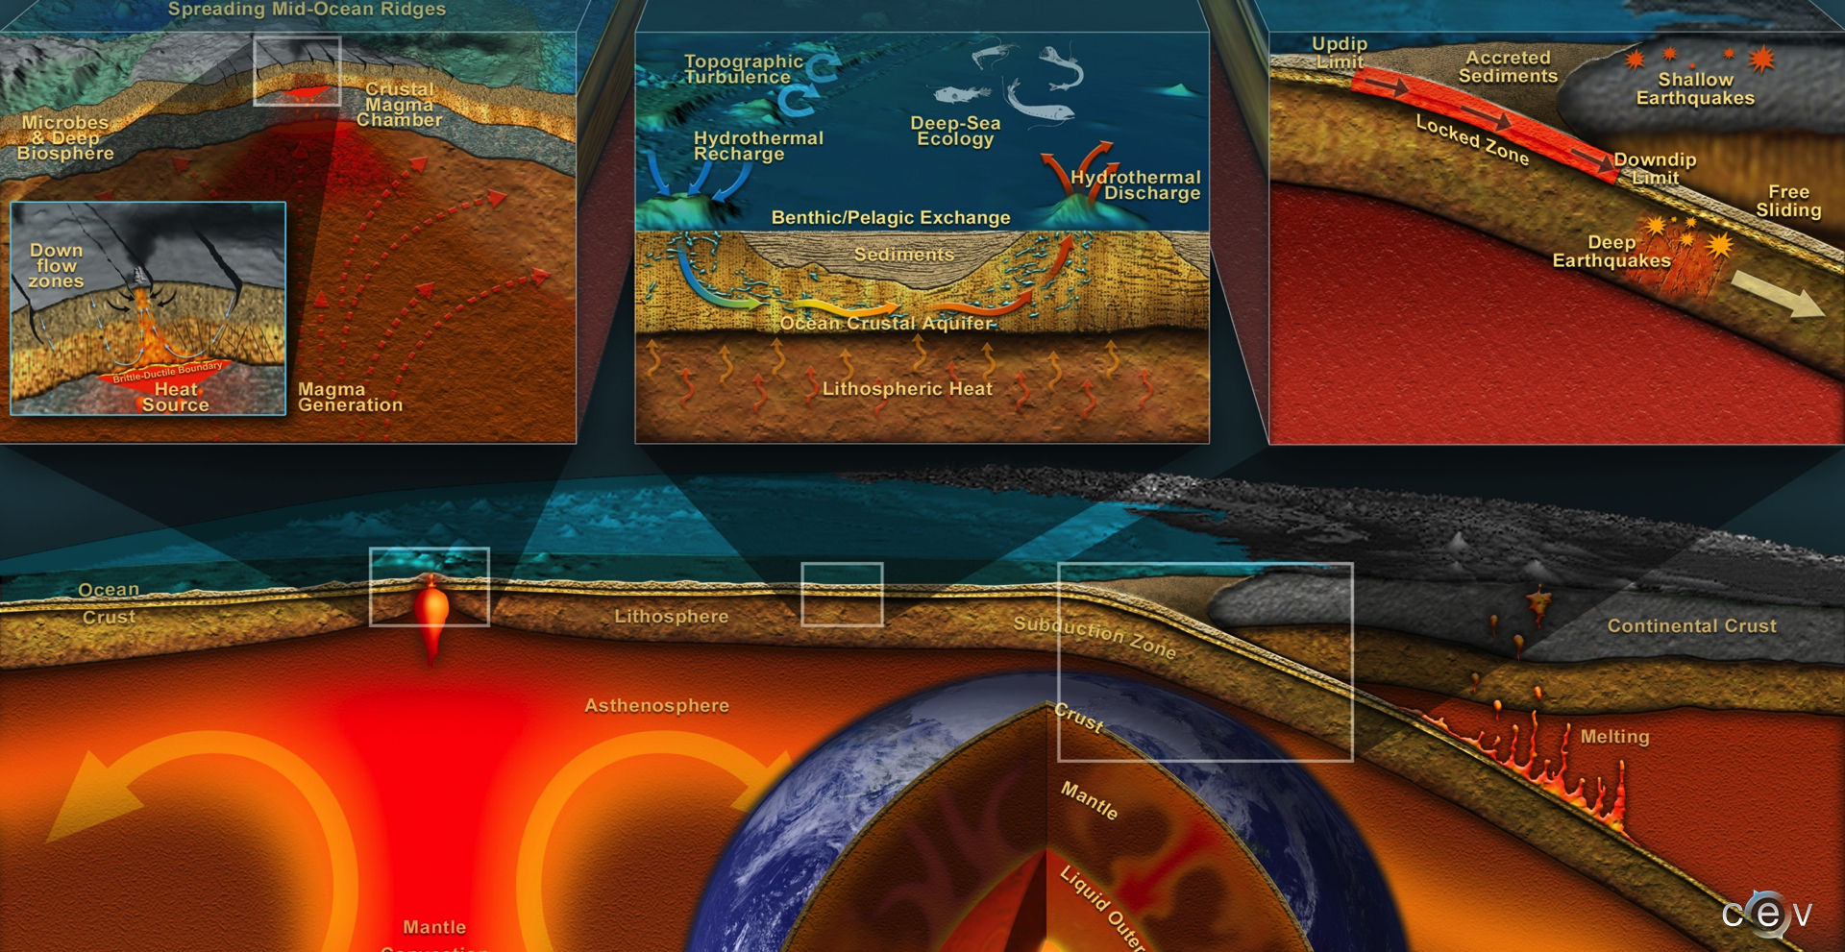
OOI Science - Spatial Scale

Slide 25
What’s next for OA research?
What we know:
Ocean acidification is ongoing, massive, increasing
Causes physiological stress for many species
Can only be mitigated by reduced CO2 emissions
What we expect:
Ecosystems will be affected (direct and indirect effects)
Ecosystems services (e.g. fisheries ) will change
What we don’t know:
Capacity for acclimation and adaptation
Effects on marine communities, ecosystems – what are the tipping points?
Coastal vs open ocean systems (variability)
Productivity and stability of fisheries
Effect of multiple stressors (climate change, acidification, reduced oxygen levels)

